Slide 1

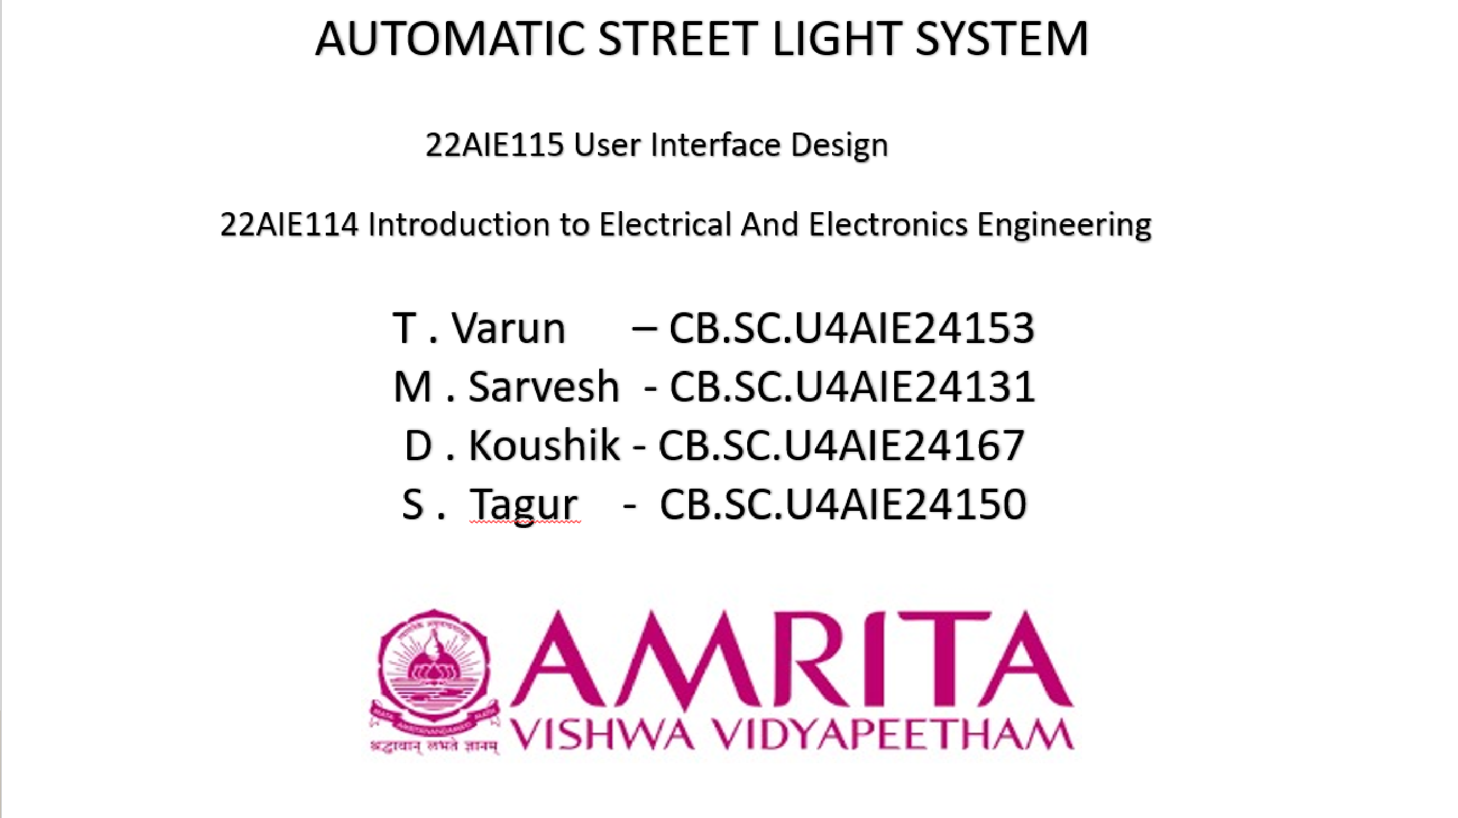

SUBTITLE

Slide 2
INTRODUTION:
Street lighting is essential for public safety during nighttime but often leads to unnecessary energy consumption due to continuous operation.
The proposed system uses an Arduino Uno and Light Dependent Resistor (LDR) to automatically switch street lights on at night and off during the day based on ambient light levels.
Infrared (IR) sensors are included to detect the presence of vehicles, allowing dynamic control of light intensity—brightening when vehicles are nearby and dimming when the road is empty.
This automation reduces manual labor and makes the system more efficient, reliable, and responsive to real-time environmental changes.
The setup is cost-effective and easy to implement, using affordable components like LEDs, resistors, sensors, and Arduino, making it suitable for streets, campuses, and public areas.

Slide 3
LITERATURE REVIEW:
S.NO: | TITLE: | YEAR: | METHODOLOGY | Contributions:
1. | Intelligent Street Lighting System Using IoT | 2017 | IoT-based sensor integration | Energy-efficient and smart adaptive lighting
2. | Design and Implementation of Smart Street Lighting System | 2018 | Microcontroller and LDR sensors | Automatic brightness adjustment based on ambient light
3. | Energy Saving Street Lighting System | 2019 | PIR sensors and LED integration | Significant reduction in energy consumption

Slide 4
Problem Statement:
Urban and Suburban Streets: Busy streets in cities and towns where consistent and energy-efficient lighting is essential for safety and visibility.
Highways: Major roads and highways, where continuous lighting is needed for vehicle and pedestrian safety.
Residential Areas: Housing complexes, neighborhoods, and local roads that require street lighting for security and navigation after sunset.
Parking Lots and Walkways: Public parking spaces and pedestrian walkways where lighting is essential for security and safety.
Parks and Gardens: Outdoor spaces where lighting is needed after dark but can be controlled to save energy during non-peak hours.
Problem Definition: Wastage of Energy Increased Costs Environmental Impact Manual Monitoring and Operation Inflexibility in Response to Variable Conditions

Slide 5
Research Gaps:
Lack of Real-Time Adaptive Control Using AI/ML: While the system relies on fixed thresholds from LDR and IR sensors, it doesn't incorporate machine learning algorithms to adaptively adjust brightness or predict usage based on traffic patterns, weather conditions, or seasonal variations.
Limited Communication and Integration Capabilities: The current model is standalone and lacks IoT connectivity or wireless communication (e.g., Bluetooth, Wi-Fi, or LoRa) for remote monitoring, control, and data analytics, which are essential for scalable smart city infrastructure.
Energy Source Optimization Not Implemented: Though the system mentions energy savings using LEDs, it doesn't integrate renewable energy sources (like solar panels) or energy storage mechanisms, nor does it optimize energy distribution based on usage and location-specific conditions.

Slide 6
METHODOLOGY:
Light Detection Using LDR :
The LDR continuously monitors ambient light levels. When the surrounding light falls below a preset threshold (indicating dusk or darkness), it sends a signal to the Arduino microcontroller.
Microcontroller Activation:
The Arduino processes the signal received from the LDR. If low light is detected, it activates the street lighting system.
Motion Detection Using IR Sensors :
IR sensors are positioned to detect the movement of vehicles or pedestrians. If motion is detected, the IR sensor sends a signal to the Arduino to turn ON the street lights at 100% brightness.

Slide 7
METHODOLOGY:
Energy Saving Mechanism :
In the absence of motion, the microcontroller reduces the brightness of the street lights, thus conserving energy. This dimming feature helps reduce power consumption by up to 60% compared to systems that keep lights at full brightness all night.
System Feedback and Control :
The Arduino controls the LEDs based on real-time input from both the LDR and IR sensors. This dual- input system ensures that lights are ON only when needed (at night and when motion is detected), and OFF or dimmed when not required.
Software and Programming :
The system is programmed using the Arduino IDE.
The code reads analog input from the LDR and digital input from the IR sensors . Based on sensor values, it controls the LED output via GPIO pins.

Slide 8
Objectives:
To design an automatic street light system that uses an LDR sensor to switch lights on at night and off during the day, reducing manual operation.
To detect vehicles or people using IR sensors and adjust the brightness of street lights only when needed, saving electricity and improving energy efficiency.
To create a cost-effective and smart lighting solution using Arduino, aiming to enhance road safety, reduce power waste, and lower maintenance efforts

Slide 9
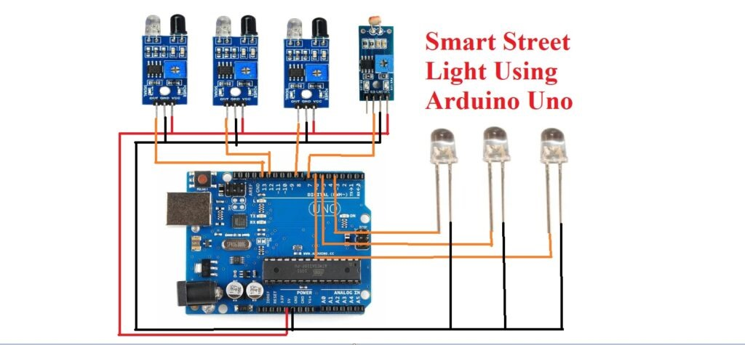
Circuit Diagram:

Slide 10
Conclusion:
The automatic street light system successfully reduces power consumption by turning lights on only in the dark and when vehicles are detected, making it energy-efficient.
Using Arduino and sensors like LDR and IR makes the system low-cost, reliable, and easy to implement, especially in urban and rural areas.
This system also reduces the need for manual work and improves road safety, making it a practical solution for modern smart cities.

Slide 11
Future Scope:
Integration with solar panels can make the system more energy-efficient and environmentally friendly by
using renewable energy sources.
Adding wireless communication (like Bluetooth or IoT) can help in remote monitoring and control of the street lights, making it smarter and easier to manage.
Using machine learning and advanced sensors can improve the system’s ability to detect traffic patterns
and adjust lighting more intelligently.

Slide 12
THANK YOU!

